Slide 1
NLP

Slide 2
Deep Learning
Compositionality
And Recursive Neural Networks

Slide 3
Compositional Semantics
Given:
Vector representations of individual words
Needed:
Representations of units such as phrases, sentences
Early work:
Pointwise sum, multiplication
Mitchell and Lapata 2010, Blacoe and Lapata 2012
Neural methods:
Tree RNN, etc.

Slide 4
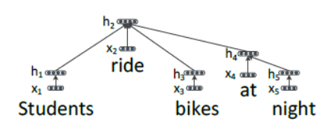
Recursive Neural Tensor Networks (RNTN) for Sentiment Analysis
[Socher et al. 2013, 2014]

Slide 5
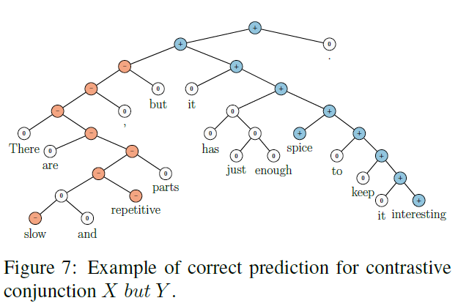
Recursive Neural Tensor Networks
Socher et al. (2013)
Recursive Deep Models for Semantic Compositionality Over a Sentiment Treebank

Slide 6
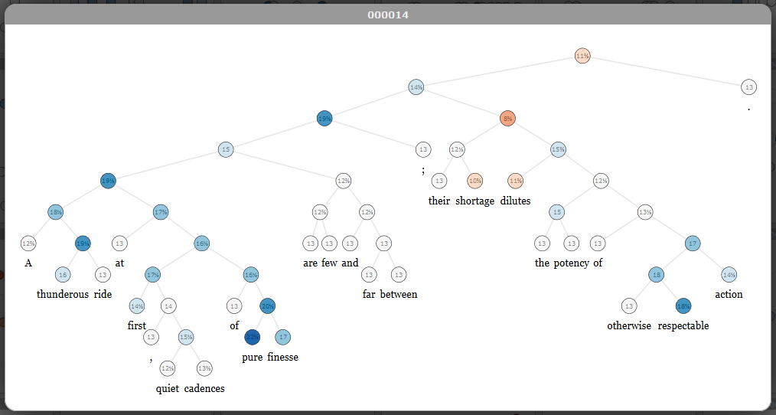
Stanford Sentiment Treebank

Slide 7
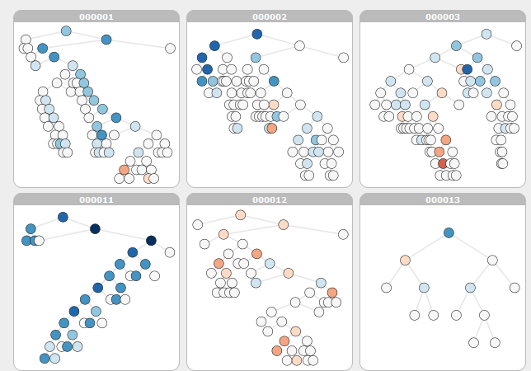
Stanford Sentiment Treebank
https://nlp.stanford.edu/sentiment/treebank.html

Slide 8
Stanford Sentiment Treebank

Slide 9
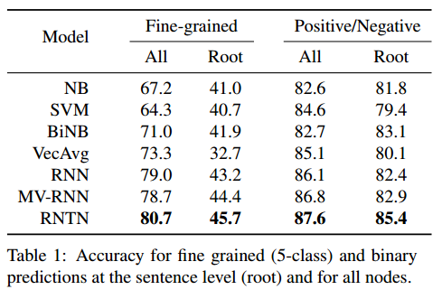
Recursive Neural Networks
Socher et al. (2013)
Recursive Deep Models for Semantic Compositionality Over a Sentiment Treebank

Slide 10
Dealing with Negation
[Socher et al. 2013]

Slide 11
Dealing with Negation
[Socher et al. 2013]

Slide 12
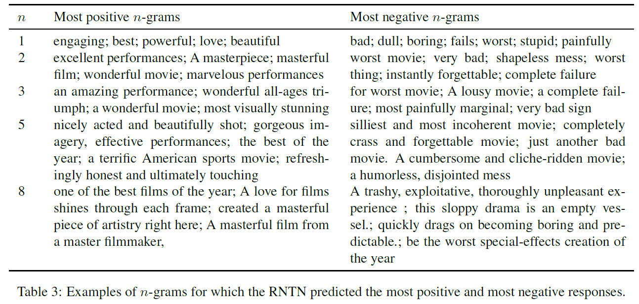
Dealing with Negation
[Socher et al. 2013]

Slide 13
Non-compositionality
BLACK CAT = BLACK + CAT
BLACK MARKET ≠ BLACK + MARKET

Slide 14
NLP

